Slide 1
Smart Incubator

Slide 2
This project consists of:
1 Arduino UNO R3 Board
1 PIR Sensor
1 Digital Active Buzzer
1 DHT12 Temperature/Humidity Sensor
1 Relay Switch
1 Warming Lamp
1 External Battery Pack

Slide 3
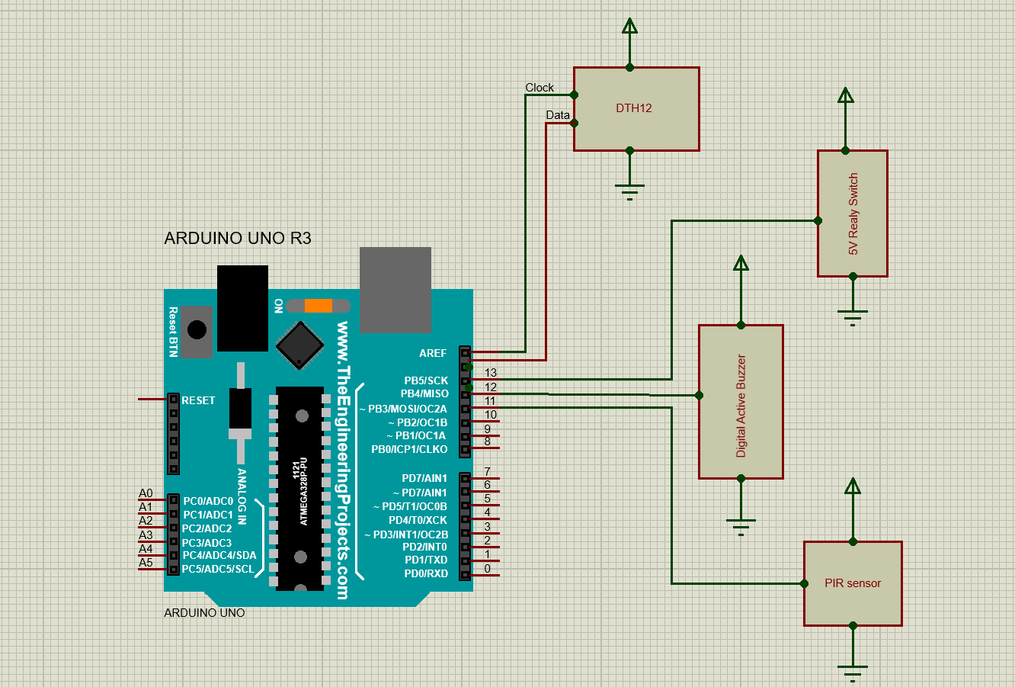
Schematics of setup

Slide 4
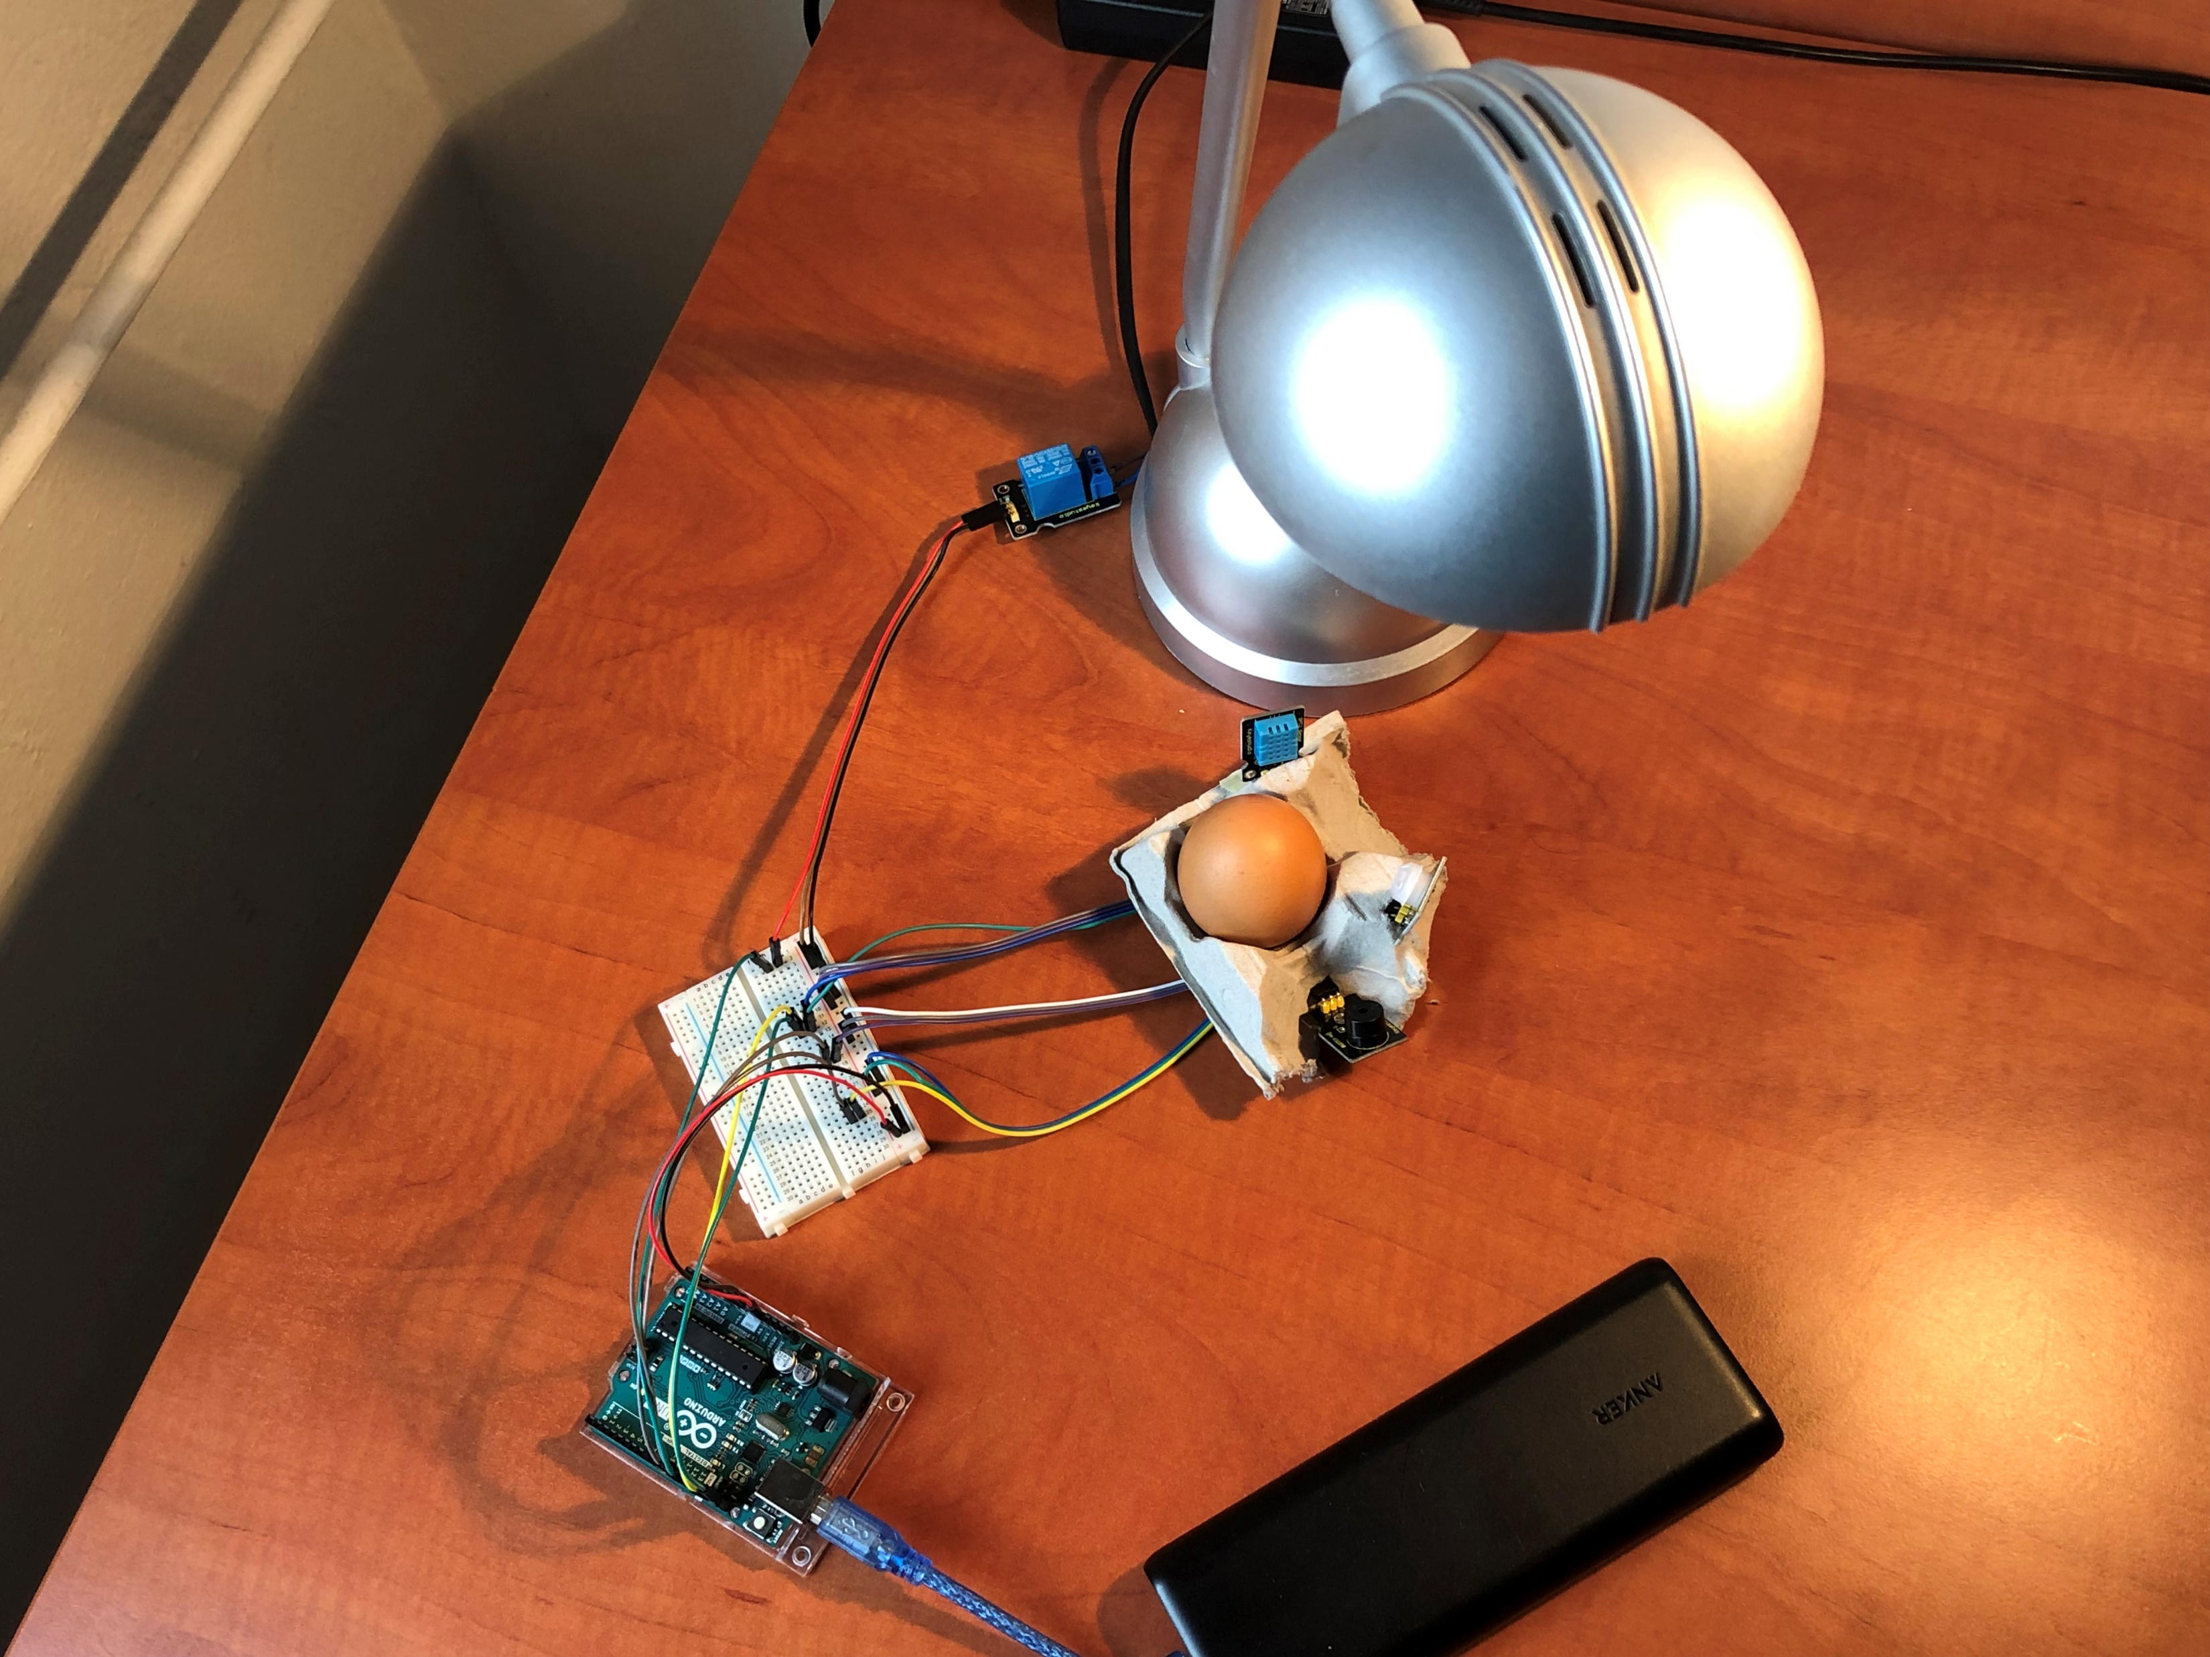
Simple practical test of the setup

Slide 5
Click to show video

Slide 6
..for any extra information or question, or perhaps business proposal feel freely to contact us at:
e01229252@student.tuwien.ac.at
e01129072@student.tuwien.ac.at
Thanks for the attention

